Slide 1
Research Progress

Slide 2
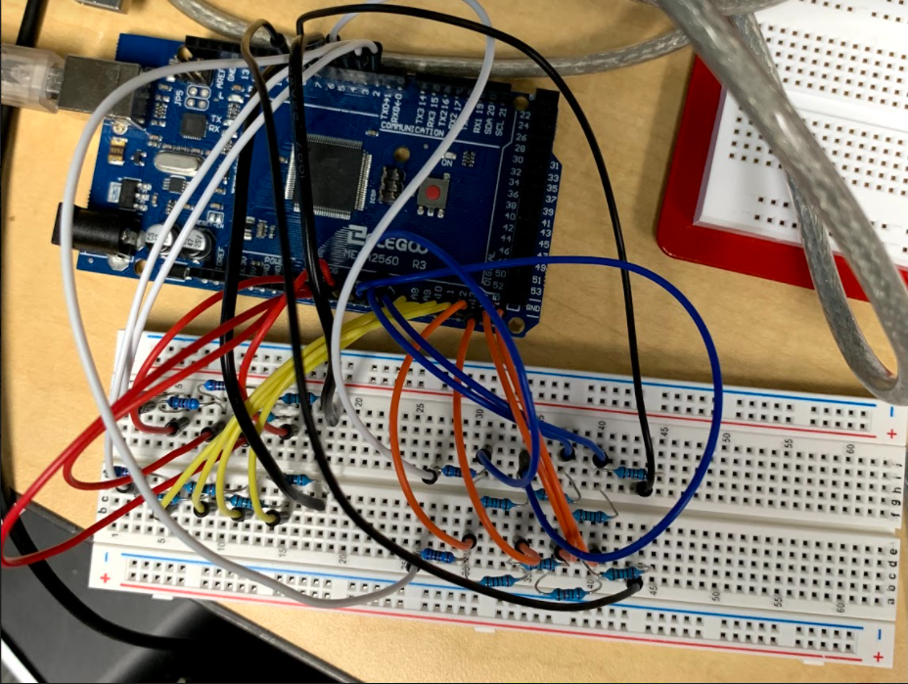
Week 1
Learned how to use Arduino, developed basic circuits and tested them
Created a prototype circuit w/ Arduino to function as an Ohmmeter that can read off the resistance values of a 2x2 matrix of unknown resistors--uses Analog Pins between each unknown resistor

Slide 3
Week 2
Issues with original design: impractical for larger size arrays (requires too many analog pins using the subtractive voltage method)
New design: try NxM matrix with only one reference resistor at the bottom of each column, which would require M analog pins rather than the previous N*M analog pins
Issues: unwanted current paths cause inaccurate resistance readings--for example, applying a voltage to one row and holding the others at 0V would cause unwanted current paths to branch off, and the current through the reference resistor wouldn’t equal the current through the desired resistor
Next idea: mimic our 1T1R model by putting a transistor in series with each resistor to control the direction of current flow, not allowing any backtracking of current into undesired rows--current through reference==current through unknown
Issues: Figuring out how to minimize current leakage, how to properly get transistors in either the “off” state or “saturation” and not “ohmic/linear”
Diode Method: Hook up each resistor in series with a diode so that applying a voltage in one row will not leak current into a different row because the diode will control the direction of current flow. I drew up a schematic on LTSpice, and breadboarded with LEDs as diodes. Program: RRamArrayModel (addressing individual resistor/diode combinations in 2x2 array).
Issues: No direct way to get resistance/voltage drop over the diodes, since they are non-linear, so we can’t get accurate readings of the resistors themselves. However, it seems like it can definitely distinguish between HRS and LRS. Sarah might have an idea for how to deal with the diode resistance.

Slide 4
Week 3
Turns out, the yellow-green LEDs I’m using operate in the 1.7-1.8V forwarding voltage range, meaning I can use this to get a much more accurate feel for the voltage drop over the resistor it is in series with in its cell
→ This is useful because now our decision of LRS and HRS will be very clear and accurate, so we can demonstrate the “set” and “reset” types of stages that we do with the memristors with potentiometers that have variable resistance
It seems that when multiple rows are activated at the same time, they act as if they are in parallel so the effective resistance of the resistances in the cells can’t simply be added, but their currents can, which is how VMM works

Slide 5

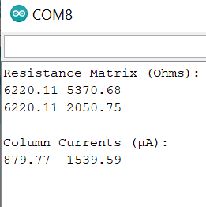
Week 3 Con’t.

Slide 6
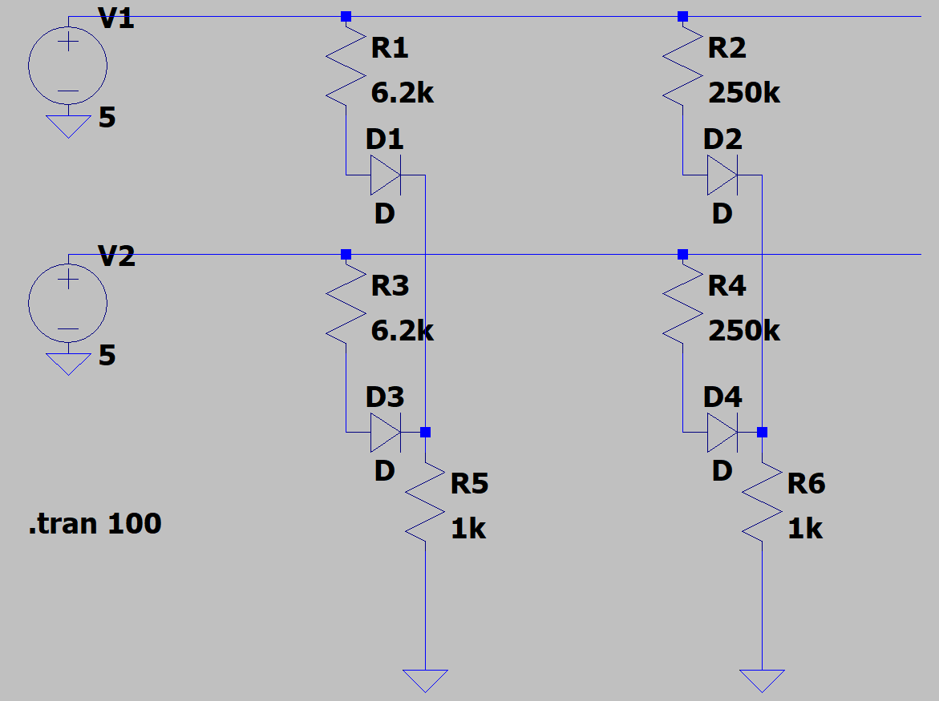
Week 3 Con’t.
Designed a project where data is taken from an ultrasonic sensor and turned into an input vector of voltages, and the input vector is multiplied into a 2x2 matrix of “set” resistances (weights), and the current sums for each column are used to determine which way to spin the motor.
Input Vector
(Voltages determined by sensor)
Weight Matrix
(Resistances we set)
Output Vector (Column Current Sums from V x G = I)

Slide 7
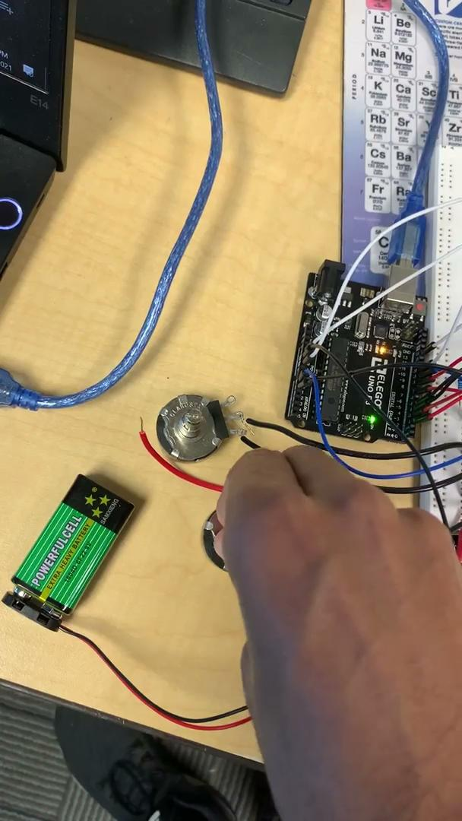
Week 3 Con’t.
Column of potentiometers → HRS, fan goes CCW
Column of potentiometers → LRS, fan goes CW

Slide 8
Week 3 Con’t.
Changes to design: change the code so that once an object is detected within 10 cm of the sensor, the speed of the motor has a dependence on the computed distance
Future plan: Basic image recognition with in memory computing

Slide 9
Week 4
Idea: Have an array of fixed resistances of HRS and LRS to represent a black and white image, and take another image as input and compare them to see if they match.
Notes about implementation: HRS=33k (match voltage = 4.80V), LRS=6.2k (match voltage = 2.41V)--> these voltages had to be done so that PWM was always applied and converted to DAC, and the voltages were high enough for the LED to pass current through
Also used HRS=100k (match voltage = 4.71V), LRS=6.2k (match voltage = 1.96V)
Another easy feature is to have a program that can simply display the binary values for the image fixed into the array

Slide 10
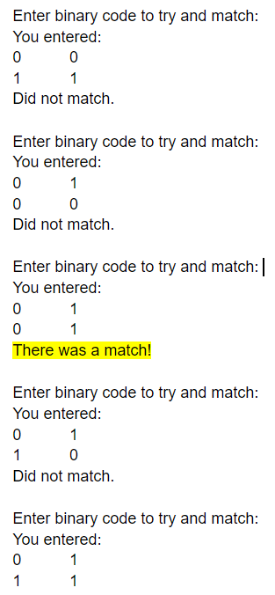
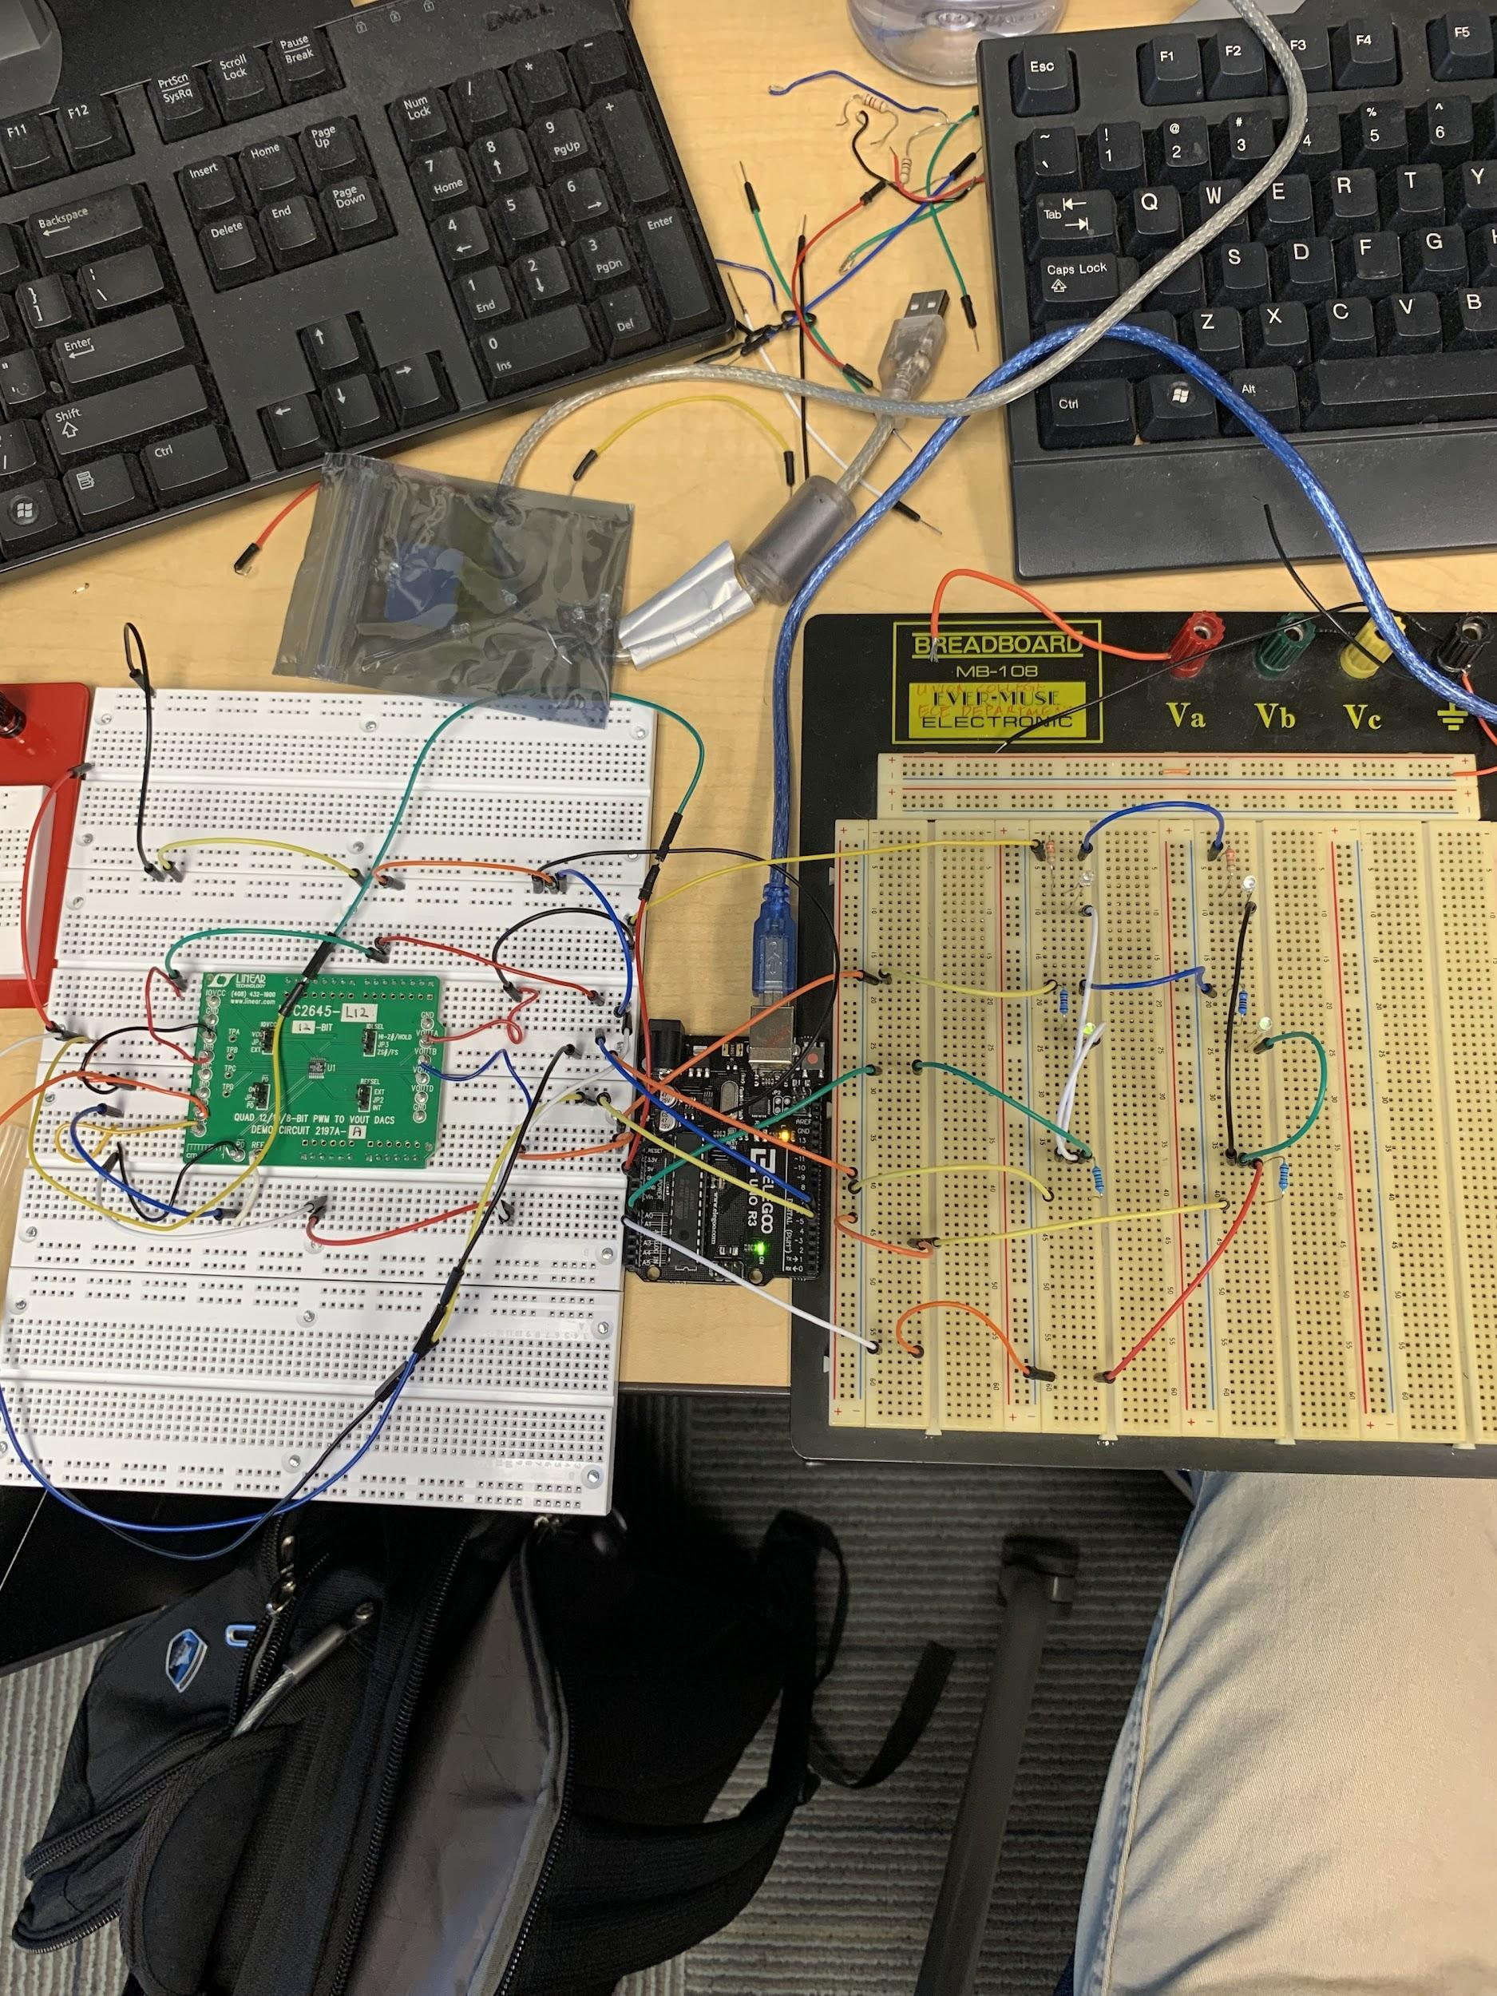
Week 4 Con’t.

Slide 11
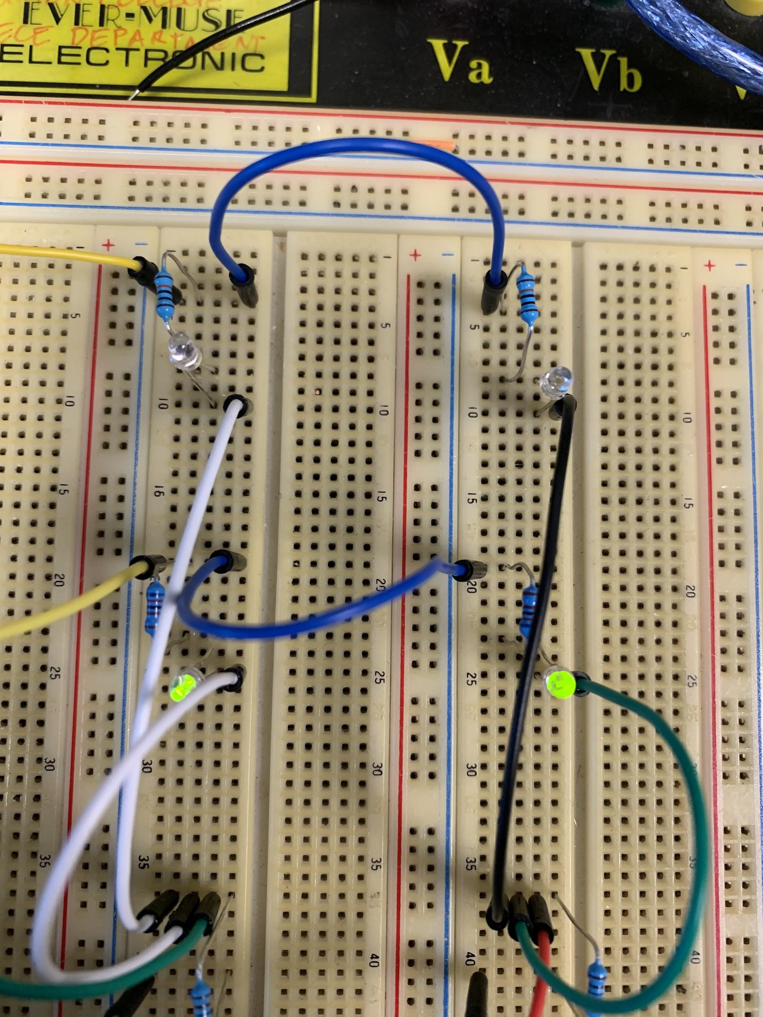
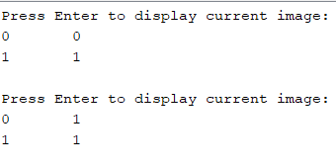
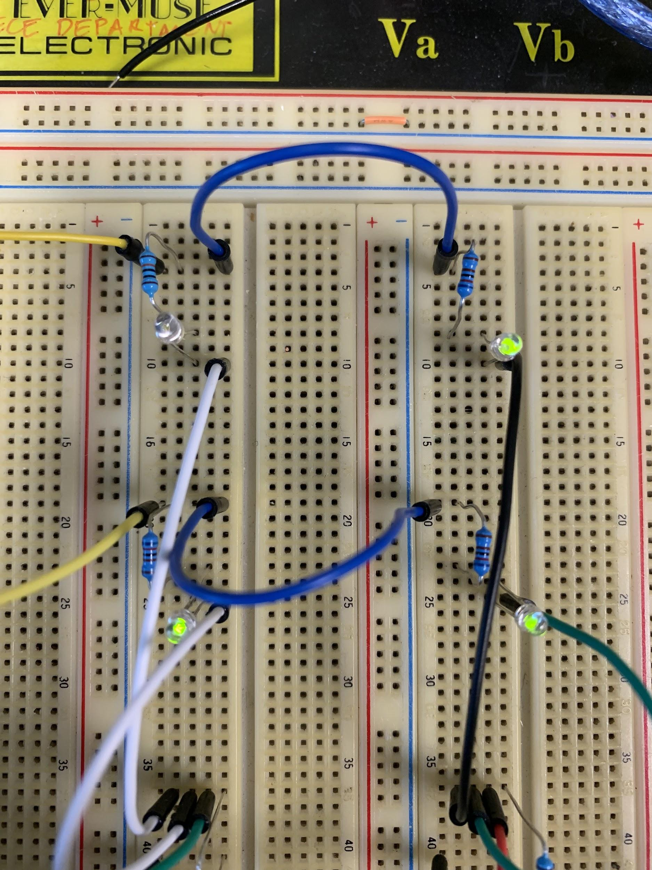
Week 4 Con’t.
Expanded the whole model to support 3x3 as well

Slide 12
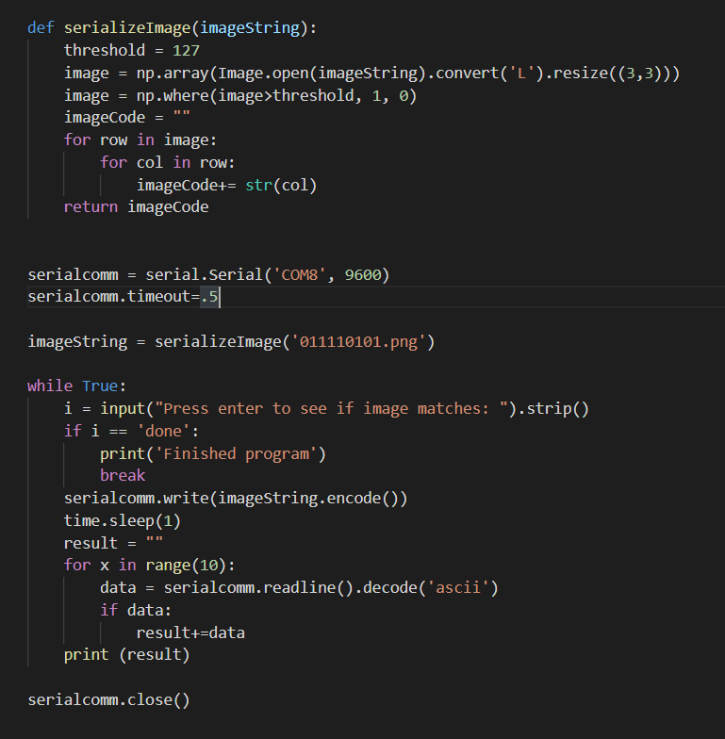
Week 5
Developed a basic Python script which communicates with serial port COM8 to enter the binary code of images we’d like to compare to our array of resistors
The Python script includes image processing and serial communication

Slide 13
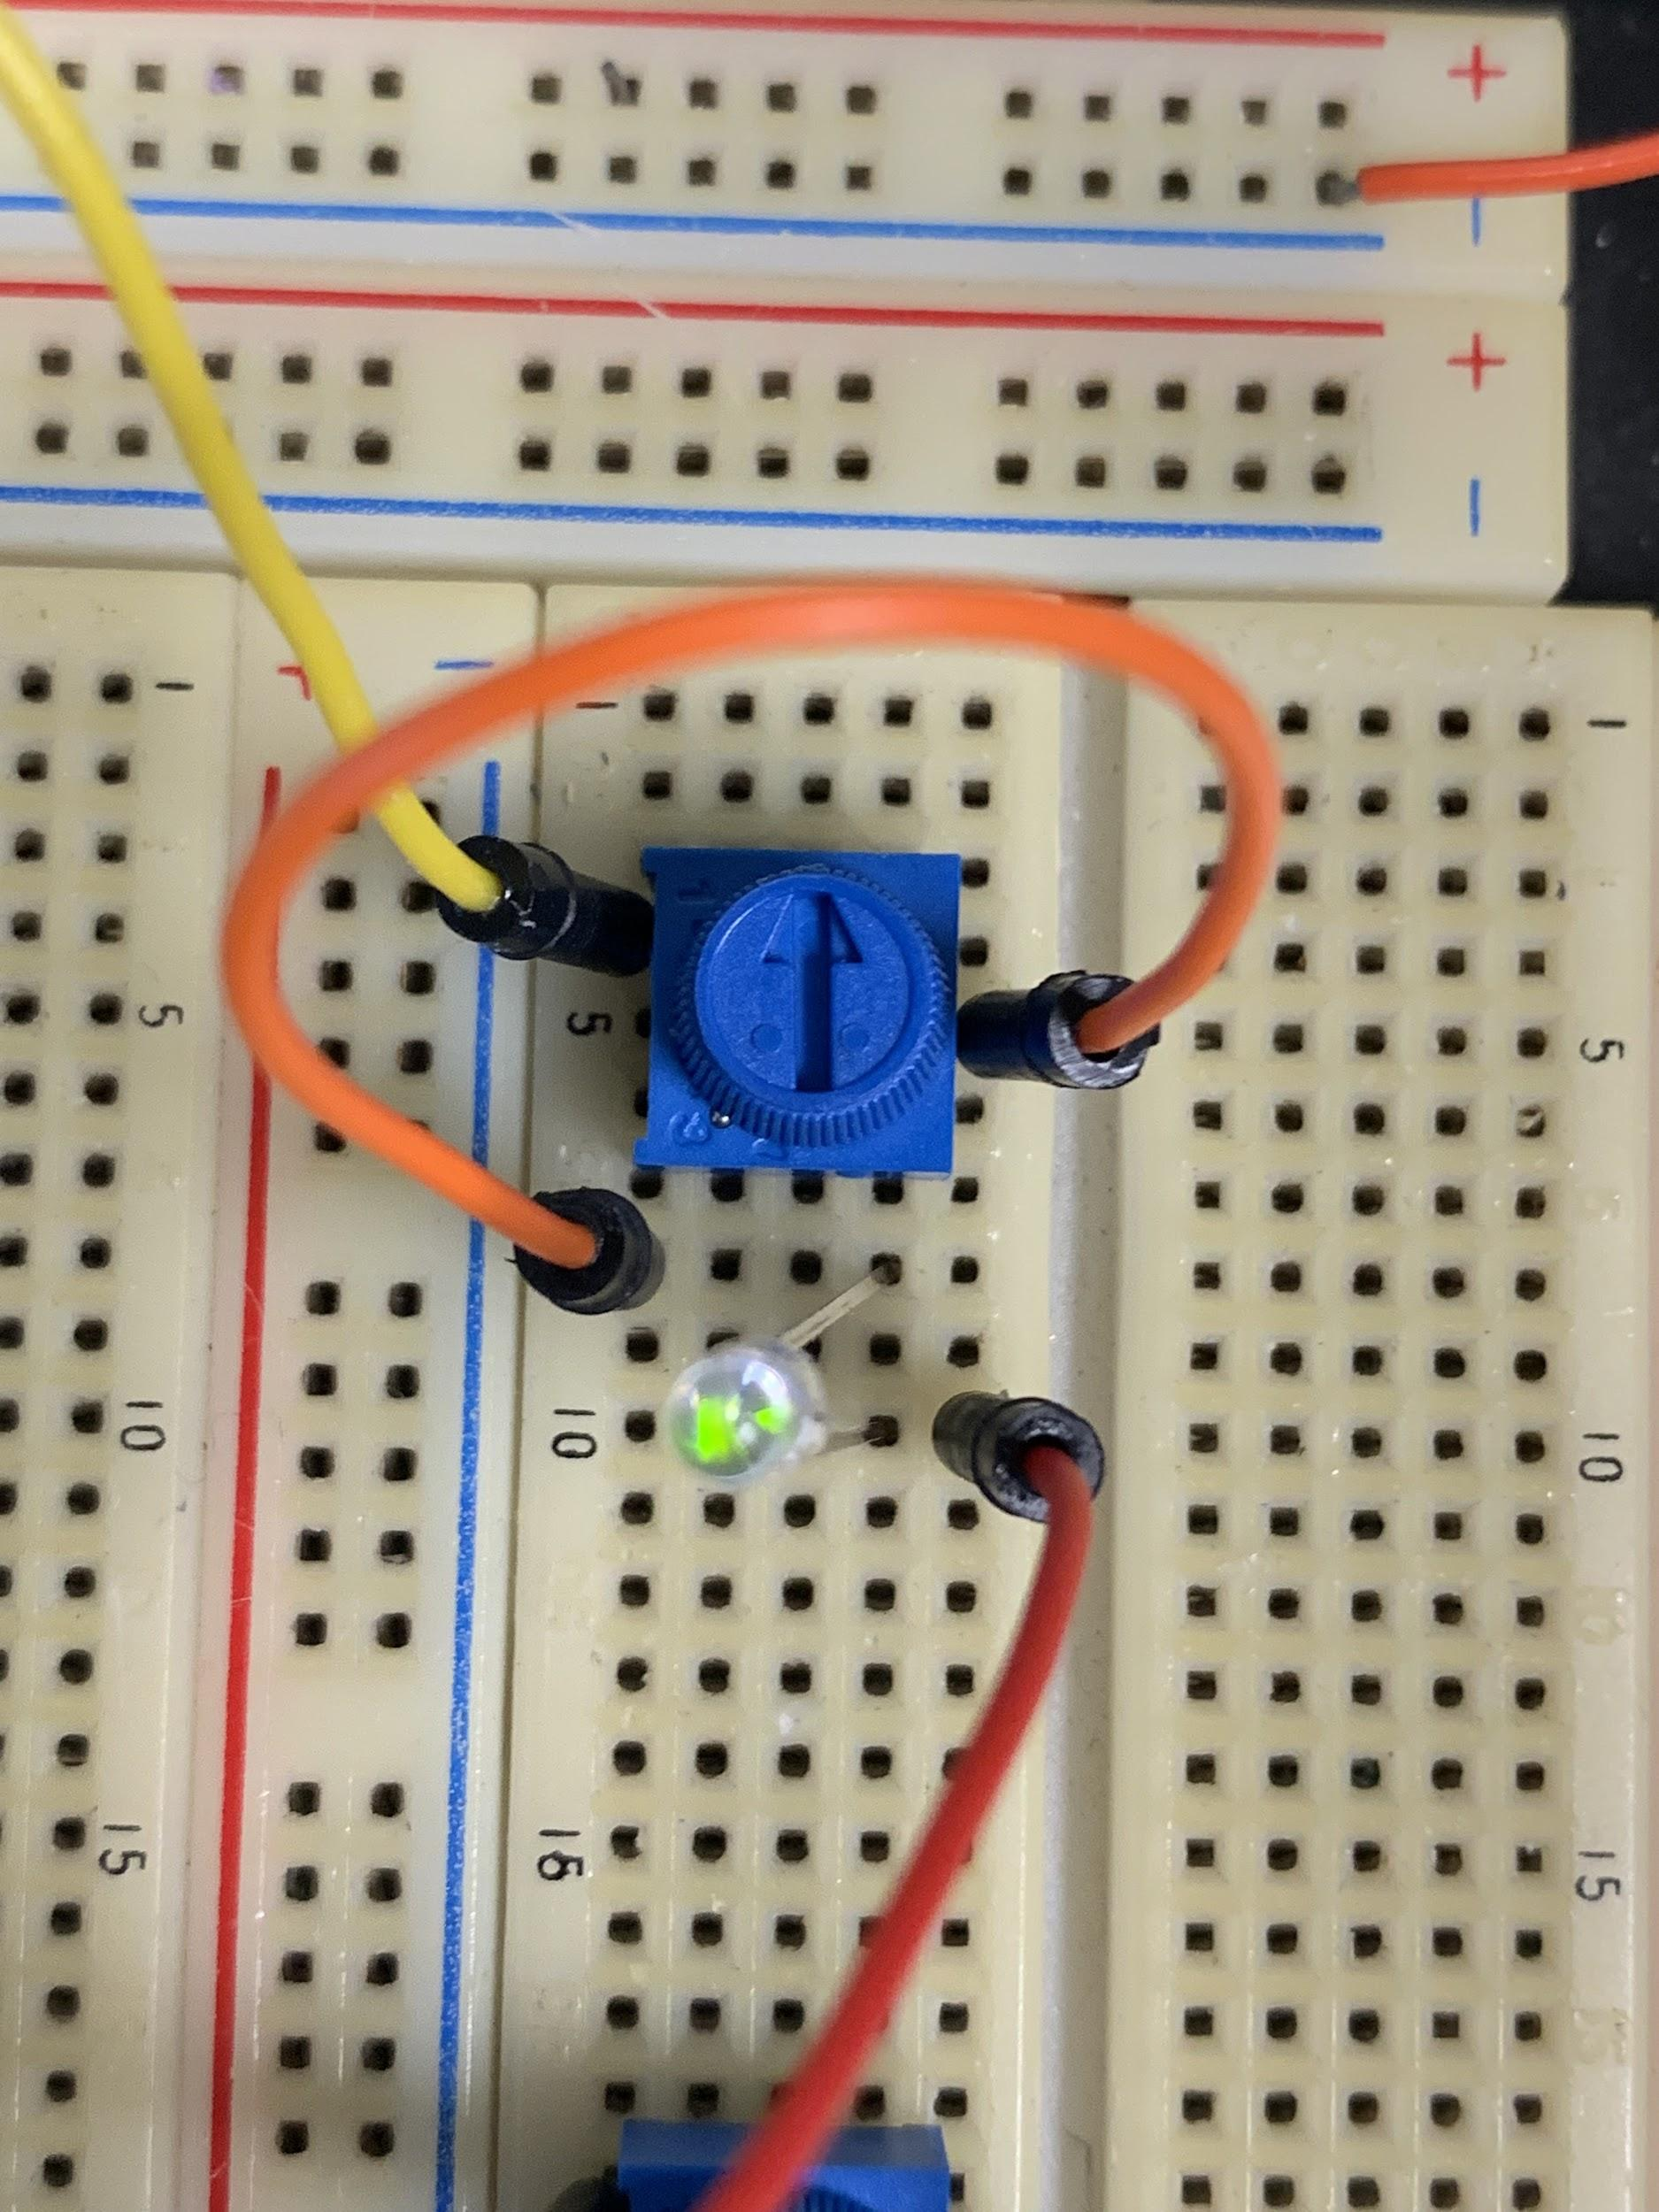
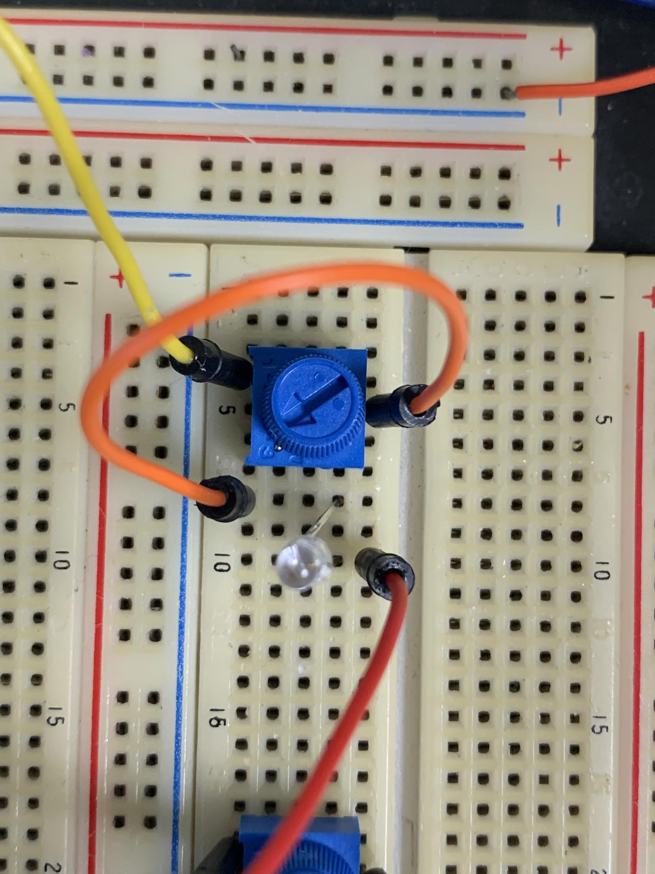
Week 5 Con’t.
LRS
Directly up
Replaced all 9 resistors with 100k potentiometers that can be toggled between HRS and LRS manually
Had to change up some of the numbers for the recognition system to still work → HRS=100k (match voltage=4.71V), LRS=17.3k (match voltage=2.22V)
Column Current Range → 57-75μA for matches
HRS
Turned all the way CW

Slide 14
Week 6
Wrote up a program to take pictures with my laptop webcam through Python, save the image, use various Python libraries to process the image into a binary code which can be communicated to the Arduino serially to compare the given image to the one encoded in the resistor array
Tried a few different methods of image processing: one is to directly grayscale an image and resize it to 3x3 to get a binary code, and the other is to fully binarize the image (into black and white) with OpenCV and then resize it and do the same thing
The advantage of the latter method is that lighting issues will be mitigated because even if something is a little darker than pure white, it will detect it as white. Also, it is a bit more lenient in terms of lining up the picture perfectly with the camera because even if a bit outside the image is white, when it is resized to 3x3, the black portion of an edge box will dominate and will come out to the desired value of 0

Slide 15
Week 6 Con’t.
Was able to generate all 512 combinations of images in a 9x9 matrix of black and white squares
Tested various images on various sets of resistances in the memory and found very good accuracy in the tests completed
Sometimes there are false negatives due to random fluctuations in the measurements by the Arduino and the inability to get perfectly accurate resistances, similar to how memristors aren’t perfect

Slide 16

Week 6 Con’t.
Using interpreted image as binary code to send to Arduino to do the image comparison
Took camera input and displayed the interpreted image

Slide 17
Week 7
Adding another application of the image recognition: if the image taken matches the image encoded into memory, turn on a motor to power a fan to spin CCW, and if it doesn’t match, then the motor will not turn on
An all black image can not be used in this system because all black is the code for a guaranteed mismatch to always turn off the motor when the program is closed
Also provided an enhanced feature where the program doesn’t have to be closed and reopened to take another image, and now typing in the word ‘next’ will rerun it properly
Developed a GUI for Jeelka’s project to help simplify communication between a microcontroller and a memristor chip

Slide 18
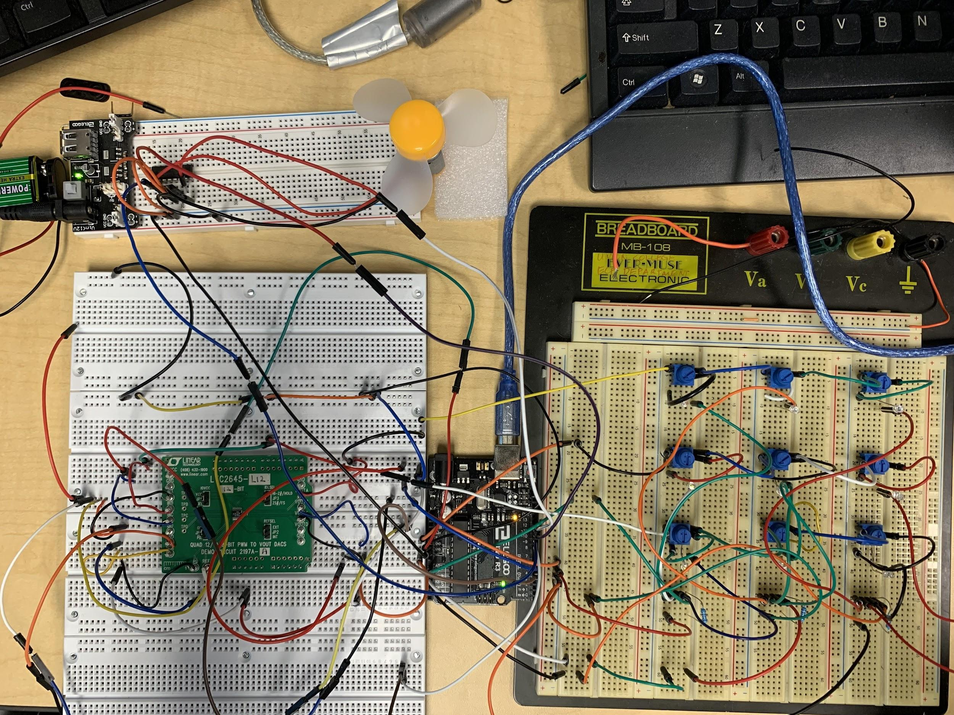
Week 7 Con’t. - Setup Diagram
External Power Supply + Motor/Fan
3x3 Array of Variable Resistors
LTC2645 Demo Board (PWM-to-DAC)
Microcontroller

Slide 19
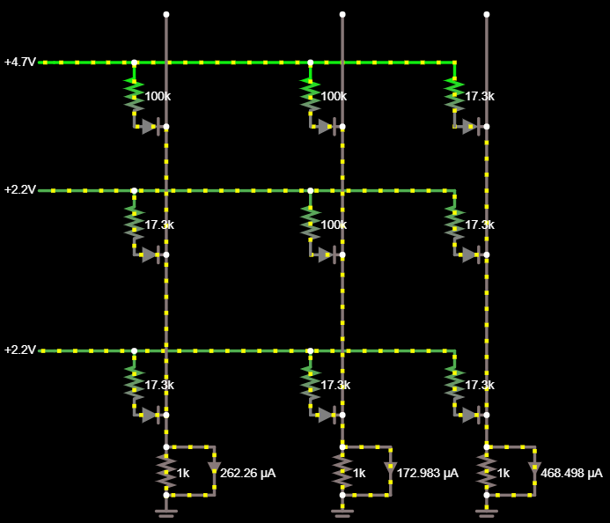
Week 7 Con’t. - Conceptual Diagram
Second column has a mismatch in the middle row that produces too low of a current, throwing off the column total
First column can be seen to match high voltage with high resistance and low voltage with low resistance to produce a current around 260 microamperes
Third column has a mismatch in the first row that produces too high of a current, also throwing off the column total

Slide 20
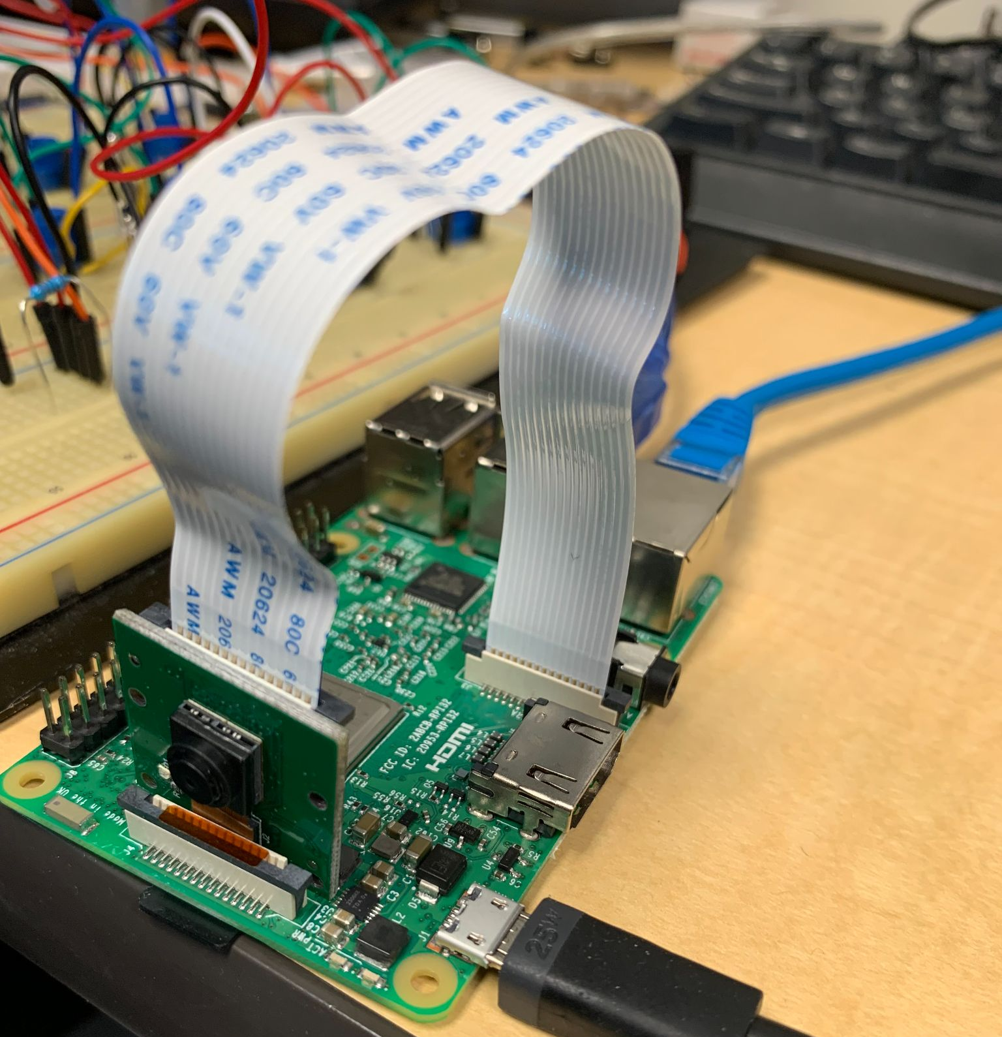
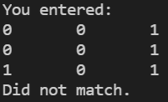
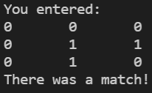
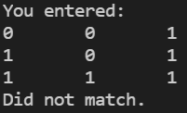
Week 8
Connected Raspberry Pi 3 to laptop screen using VNC Viewer, set up serial connection between the Raspberry Pi and Arduino
GUI for Jeelka now has multiple forms so that she can individually address and perform operations on memristors, or she can address an entire column and program it

Slide 21
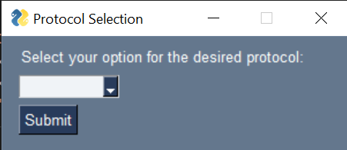
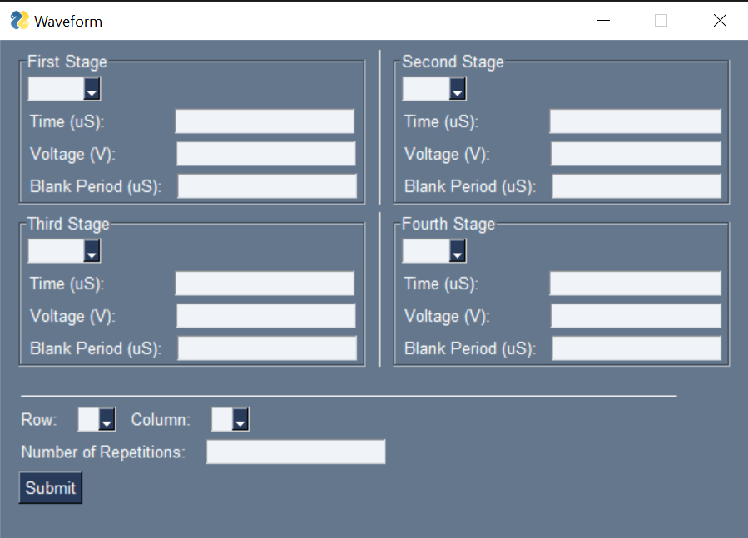
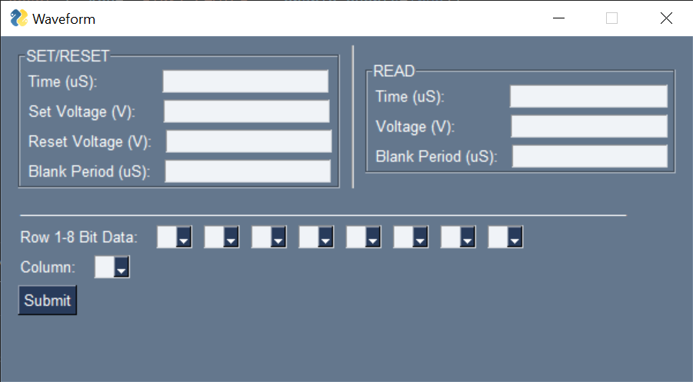
Week 8 Con’t.
1<=Row<=8
Row = 0

